Slide 1
How should we
type in AR / VR?
A mixed-methods comparison of 7 text-entry methods • Speed, accuracy & lived experience
SYNTHETIC DATA — PORTFOLIO SAMPLE
▸ 50 simulated participants
▸ 7 methods × 10 sentences
▸ 3,500 trials + 350 surveys
▸ Fully reproducible in Python
The headline
Physical keyboard still wins. Voice is fast but error-prone. No novel method wins on speed, accuracy and comfort at once.
The twist
A 5-minute tutorial lifts EMG +20% and controllers +13% — but does almost nothing for voice or a physical keyboard.
AR/VR Text Entry • Synthetic portfolio study — no real participants • N=50 simulated • See README for methods & reproducibility

Slide 2
EXECUTIVE TAKEAWAY
Start with the answer: match the method to the moment
⌨ Keep the physical keyboard as benchmark
38.6 WPM, 0.8 errors/sentence, satisfaction 4.8/7. Any headset claim should be judged against this — not against other prototypes.
🎙 Voice for long, private, hands-busy text
35.4 WPM but 2.2 errors/sentence and frustration 5.4/7. Fast to produce, slow to fix. Poor for passwords, names, public spaces.
👆 Mid-air for short bursts only
Direct touch 17.1 WPM and pinch 11.8 WPM, with exertion 4.6 and 4.2/7. Fine for a search box. Punishing for a paragraph.
38.6 WPM
Physical keyboard — mean speed
+19.6%
WPM gain from instructions — EMG
3.3 / sentence
Errors — EMG, worst accuracy
52 trials
Random glitch outliers (1.5%) — kept & flagged
▸ Recommendation — ship a portfolio of methods, not one winner: voice for dictation, surface/direct for short entry, physical for long-form.
AR/VR Text Entry • Synthetic portfolio study — no real participants • N=50 simulated • See README for methods & reproducibility

Slide 3
RESEARCH QUESTIONS & HYPOTHESES
Three questions this study was built to answer
RQ1 — Performance
Which method is fastest and most accurate on identical sentences?
H1: Physical > voice > surface > direct > controllers > pinch > EMG.
RQ2 — Onboarding
Does a 5-min tutorial + practice change performance?
H2: Help is largest for novel mental models (EMG, pinch), smallest for familiar ones (keyboard, voice).
RQ3 — Experience
Do people feel what the stopwatch shows?
H3: Perceived speed tracks WPM, but frustration tracks errors and exertion — so voice feels worse than it times.
▸ Decision this informs — which input to default to, which to offer as an alternative, and where onboarding budget actually pays off.
AR/VR Text Entry • Synthetic portfolio study — no real participants • N=50 simulated • See README for methods & reproducibility

Slide 4
STUDY DESIGN
One sentence set, seven methods, two onboarding conditions
1 · Recruit
50 adults
21–58 yrs
Mixed VR & typing skill
2 · Split
25 instructed
5-min tutorial + practice
25 uninstructed
3 · Rotate
All 7 methods
Counterbalanced order
Breaks between methods
4 · Type
Same 10 sentences
per method
Timed, errors logged
5 · Rate
After each method
Speed · frustration
Satisfaction · exertion
▸ Within-subjects for method — each person is their own control, so skill differences cancel out.
▸ Between-subjects for instructions — avoids practice carrying the tutorial effect into the control group.
▸ Counterbalancing — method order shuffled per participant to spread fatigue and learning.
Why this shape matters
It separates three things studies often blur: the method, the person, and the onboarding. That is what makes the instruction result believable.
AR/VR Text Entry • Synthetic portfolio study — no real participants • N=50 simulated • See README for methods & reproducibility

Slide 5
METHODS COMPARED
The seven contenders — from familiar to speculative
EMG hand writing
Wrist EMG reads finger micro-movements as if writing; ML guesses the word. No keyboard at all.
Surface keyboard
Virtual QWERTY tapped on a real table. Tactile surface, no physical keys.
Physical keyboard
Real Bluetooth keyboard seen via passthrough. The benchmark.
Voice dictation
Speak the sentence; ASR transcribes. Corrections counted as errors.
Direct touch
Poke a floating virtual keyboard with your index finger, letter by letter.
Point + pinch
Point at a letter, pinch to select. No surface, no contact — implicit touch.
VR controllers
Raycast pointer from each controller, trigger to select letters.
▸ Same QWERTY layout and sentence set everywhere — only the input mechanism changes.
AR/VR Text Entry • Synthetic portfolio study — no real participants • N=50 simulated • See README for methods & reproducibility

Slide 6
PARTICIPANTS & PROTOCOL
Half got a tutorial. Half were left to figure it out.
50
Simulated participants
25 / 25
Instructed / uninstructed
3,500
Timed sentence trials
350
Post-method surveys
Instructed group got…
• 5-minute guided tutorial per method
• 2 practice sentences (not scored)
• A one-card cheat sheet (gestures, correction shortcut)
• Permission to ask one clarifying question
Uninstructed group got…
• One line: “Type the sentence you see.”
• No demo, no practice, no cheat sheet
• Mirrors real first-run AR/VR onboarding today
• Same sentences, timing and surveys
▸ Skill was simulated as a per-person multiplier, so fast typists stay fast everywhere — and strugglers stay visible (slide 15).
AR/VR Text Entry • Synthetic portfolio study — no real participants • N=50 simulated • See README for methods & reproducibility

Slide 7
MATERIALS & METRICS
Ten fixed sentences, deliberately uneven
ID | Sentence (typed verbatim) | Trap
S01 | the quick brown fox jumps over the lazy dog | Baseline pangram
S02 | please schedule the meeting for tomorrow morning | Plain baseline
S03 | I need to buy milk, eggs, and bread at the store. | Commas, capital
S04 | Can you send me the report before Friday? | Question, capital
S05 | my password is much stronger than before | Password-like
S06 | We are meeting Ana at 5:30 near Gate B12. | Time, code, capitals
S07 | Don't forget to water the plants while I'm away. | Apostrophes
S08 | Invoice #4821 for $1,275.50 is due on March 3rd! | Symbols + money — hardest
S09 | the wifi password is written on the whiteboard | Plain baseline
S10 | Please RSVP to Jordan's party — it starts at 7:45 p.m.! | Apostrophe, dash, time
Quantitative (per sentence)
• WPM and seconds-per-word
• Errors per sentence (wrong / missed / extra chars, failed corrections)
• Entry time
Qualitative (survey, 1–7)
• Perceived speed
• Frustration
• Satisfaction
• Physical exertion
▸ Fixed sentences make methods comparable. Uneven difficulty makes sentence outliers findable — by design.
AR/VR Text Entry • Synthetic portfolio study — no real participants • N=50 simulated • See README for methods & reproducibility

Slide 8
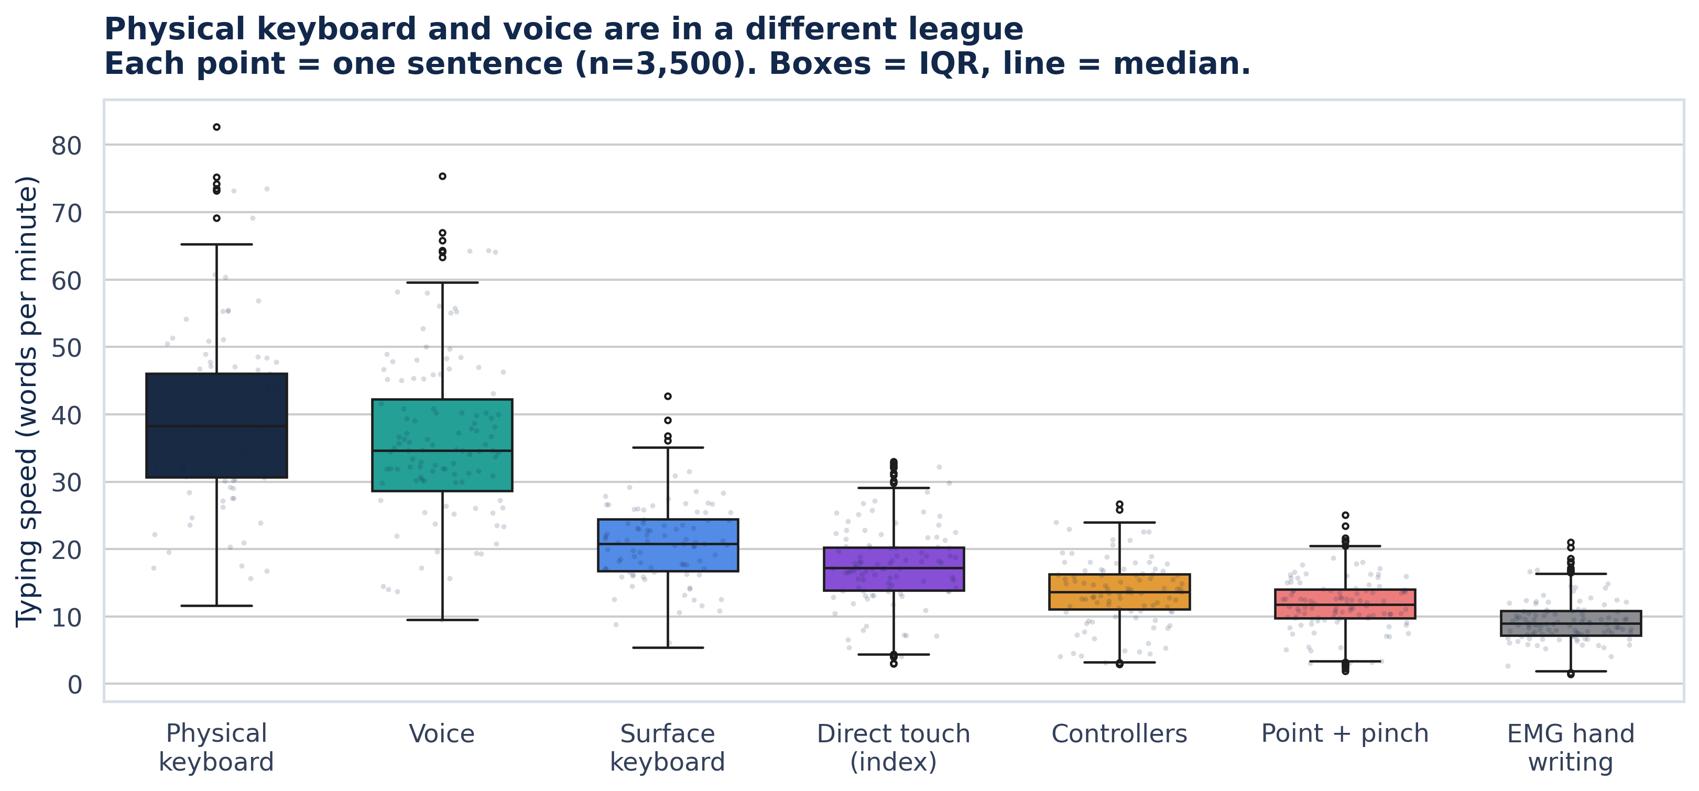
FINDING 1 · SPEED
Physical and voice lap the field — twice over
So what?
Median 38 vs 9 WPM is not a gap, it is a category difference. Novel methods compete with each other, not with the keyboard.
▸ Surface is the best novel method at ~21 WPM.
▸ EMG is slowest and most variable at the bottom.
▸ Spread matters: voice ranges 10–76 WPM by person.
AR/VR Text Entry • Synthetic portfolio study — no real participants • N=50 simulated • See README for methods & reproducibility

Slide 9
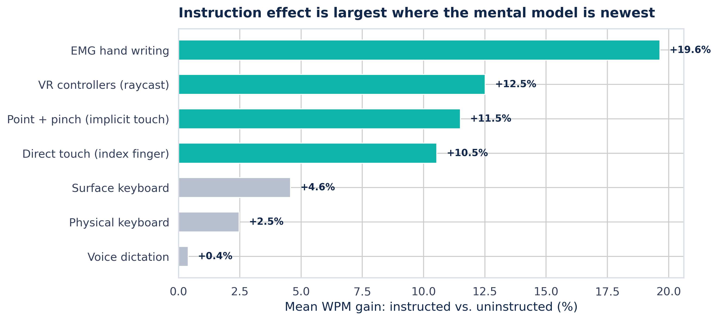
FINDING 2 · INSTRUCTIONS
Tutorial helps — where the mental model is new
So what?
EMG +19.6%, controllers +12.5%, pinch +11.5% WPM. Voice +0.4% and physical +2.5% are noise-level.
▸ Errors also fall 12–29% with instructions.
▸ Full split with CIs: next chart in appendix data.
▸ Onboarding budget belongs on novel input.
AR/VR Text Entry • Synthetic portfolio study — no real participants • N=50 simulated • See README for methods & reproducibility

Slide 10
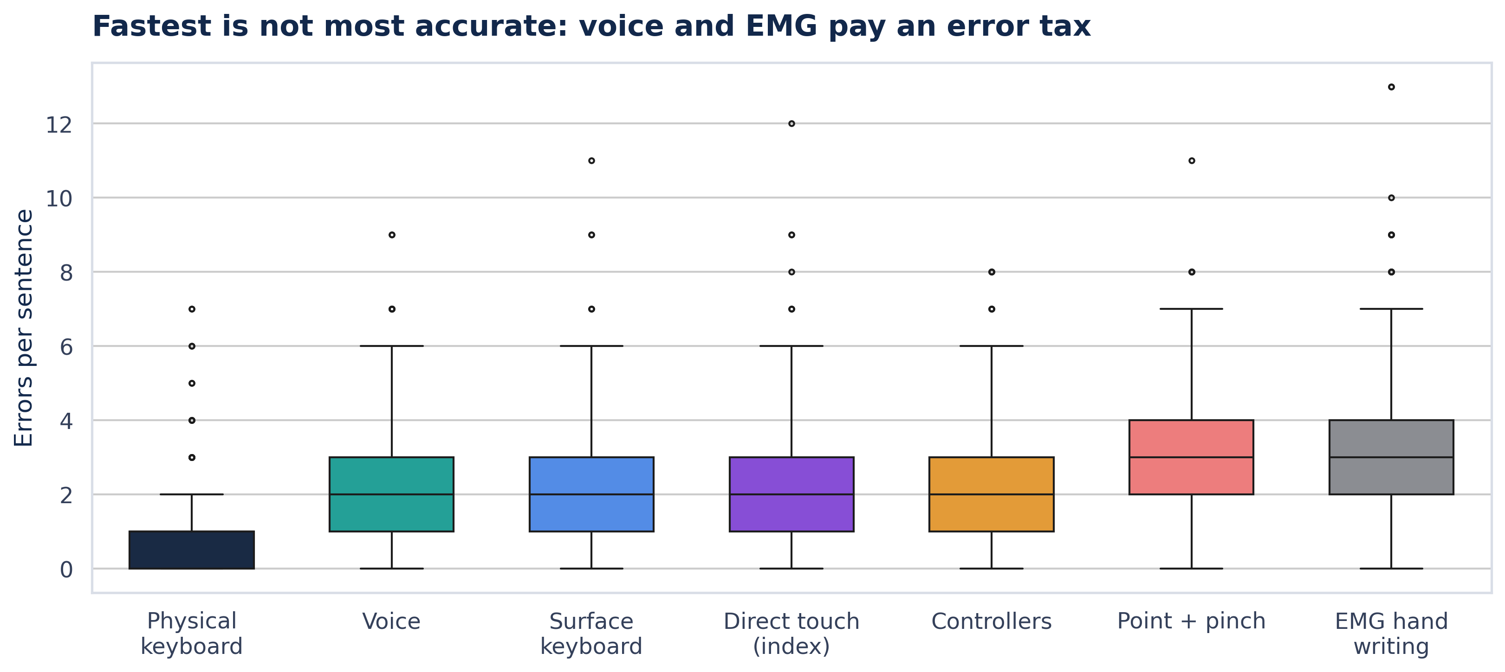
FINDING 3 · ACCURACY
Fastest is not cleanest
So what?
Voice produces text fast and errors fast (2.2/sentence). Physical is both fast and clean (0.8). EMG is slow and error-dense (3.3).
▸ Error cost is correction time users actually feel.
▸ Pinch false-selections drive its 2.9 errors.
▸ Report speed and errors together — always.
AR/VR Text Entry • Synthetic portfolio study — no real participants • N=50 simulated • See README for methods & reproducibility

Slide 11
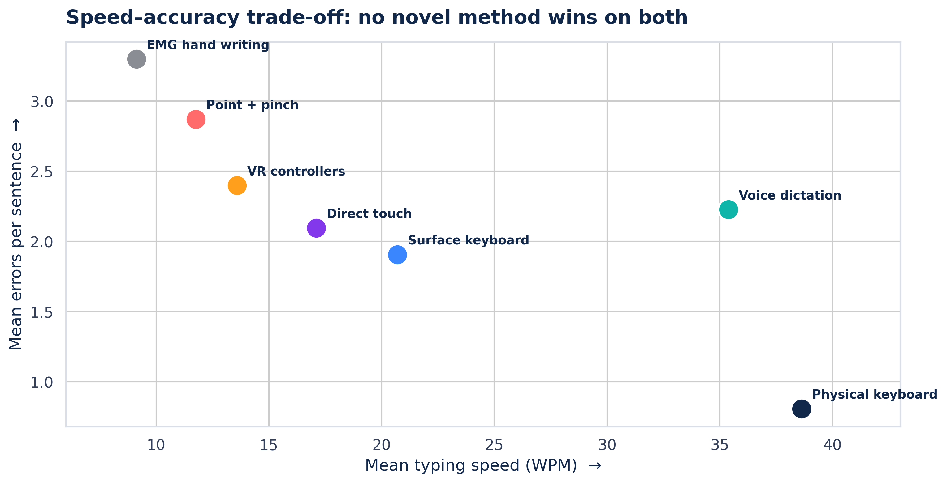
FINDING 4 · TRADE-OFF
No novel method wins on speed and accuracy
So what?
Bottom-right is the goal (fast + clean). Only physical lives there. Every novel method trades one for the other.
▸ Surface is the least-bad compromise.
▸ Voice: pick it for volume, budget for cleanup.
▸ EMG needs accuracy work before speed work.
AR/VR Text Entry • Synthetic portfolio study — no real participants • N=50 simulated • See README for methods & reproducibility

Slide 12
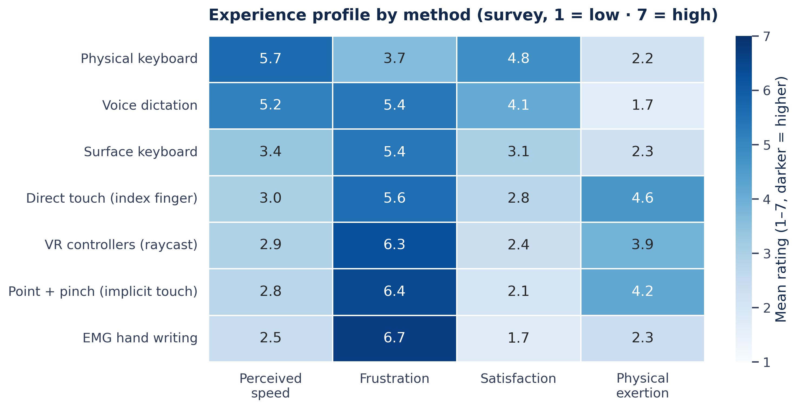
FINDING 5 · EXPERIENCE (SURVEY)
People feel the gap — and the correction burden
So what?
Darker = higher rating. Read frustration and exertion as bad-when-dark: EMG frustration 6.7/7 despite low exertion — it is cognitive, not physical.
▸ Perceived speed mirrors measured WPM.
▸ Voice frustration (5.4) exceeds surface (5.4) despite 15 extra WPM.
▸ Satisfaction never tops 4.8 — headroom everywhere.
AR/VR Text Entry • Synthetic portfolio study — no real participants • N=50 simulated • See README for methods & reproducibility

Slide 13
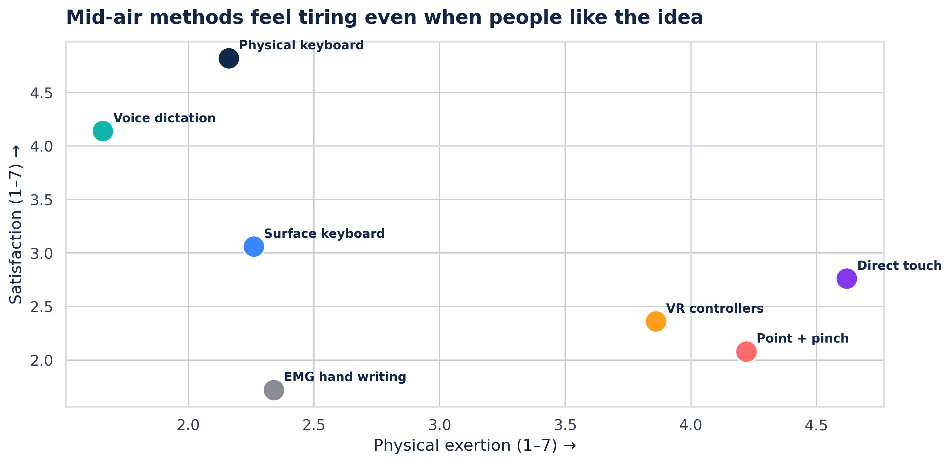
FINDING 6 · EFFORT VS SATISFACTION
Mid-air is tiring, EMG is maddening — differently
So what?
Top-left is ideal (satisfying, effortless). Direct touch and pinch sit bottom-right-ish on effort; EMG is low-effort but least satisfying.
▸ Gorilla-arm is real after ~10 sentences.
▸ Low exertion does not rescue a method users cannot control.
▸ Design implication: rest surfaces and arm support.
AR/VR Text Entry • Synthetic portfolio study — no real participants • N=50 simulated • See README for methods & reproducibility

Slide 14
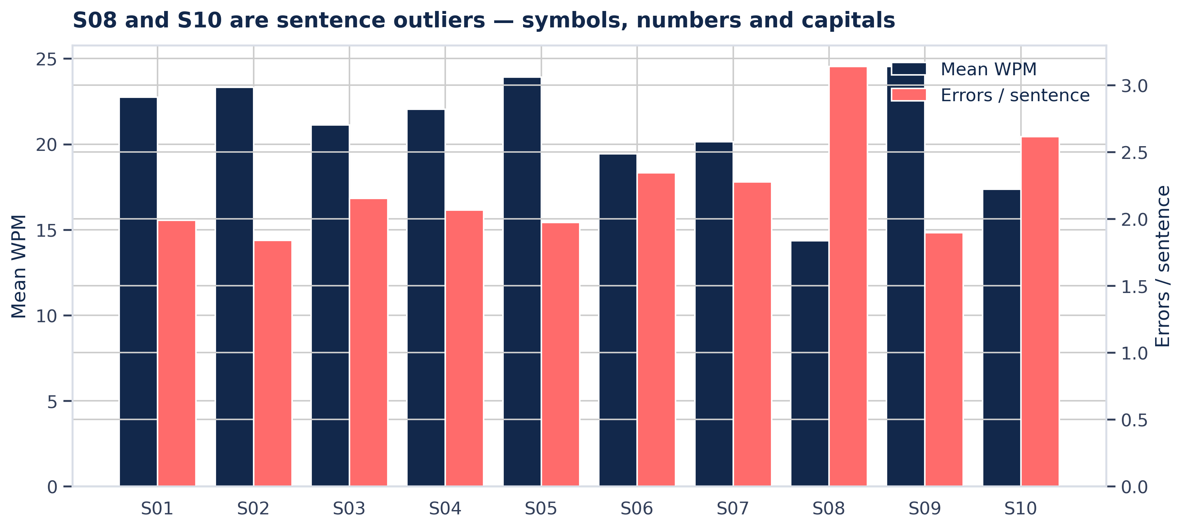
OUTLIERS I · SENTENCES
Two sentences break every method
So what?
S08 drops to ~14 WPM with 3.1 errors/sentence across all methods. S10 is second-worst. The method did not fail — the content did.
▸ Numbers and symbols force layout switching.
▸ Capitals and apostrophes punish pinch/EMG most.
▸ Keep S08/S10 in the set: real text looks like this.
▸ Other explanations to rule out: fatigue (order was counterbalanced), one bad method (effect is cross-method).
AR/VR Text Entry • Synthetic portfolio study — no real participants • N=50 simulated • See README for methods & reproducibility

Slide 15
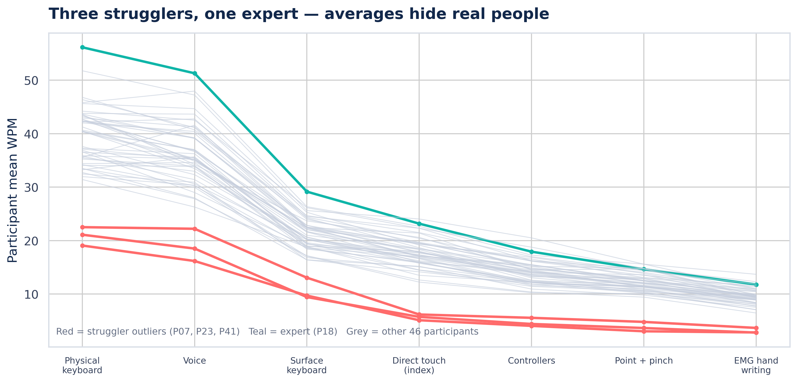
OUTLIERS II · PEOPLE
Averages hide three strugglers and one expert
So what?
P07, P23, P41 (red) collapse on tracking-based methods but are merely slow on a physical keyboard. P18 (teal) is fast everywhere. This is a fit problem, not effort.
▸ Possible causes: hand-tracking occlusion, EMG fit / sweat, tremor, glasses / passthrough blur, unfamiliar gesture vocabulary.
▸ Do not delete them: they are the accessibility story. Report results with and without, and design a fallback input.
AR/VR Text Entry • Synthetic portfolio study — no real participants • N=50 simulated • See README for methods & reproducibility

Slide 16
INTERPRETING THE INSTRUCTION EFFECT
Why a tutorial helps — and why sometimes it cannot
✓ Instructions help when…
• The gesture is invisible (pinch, EMG) — no affordance to discover
• A correction shortcut exists but is hidden
• Calibration quality depends on how you start
• Fear of ‘breaking it’ makes people tentative
✗ Instructions cannot fix…
• A ceiling: keyboard/voice are already at skill limit
• Physics: arm fatigue, raycast jitter, tracking loss
• ASR limits: accent, names, homophones, noise
• Content: symbols and numbers stay slow (S08)
▸ Alternative explanations checked — practice alone (uninstructed improve little within 10 sentences), motivation (survey effort ratings similar), and sentence order (counterbalanced).
▸ Design rule — teach the invisible, do not lecture the familiar. Spend onboarding seconds where the gain is +10–20%, not +0.4%.
AR/VR Text Entry • Synthetic portfolio study — no real participants • N=50 simulated • See README for methods & reproducibility

Slide 17
RECOMMENDATIONS BY USE CASE
Recommendation: a portfolio of inputs, not a winner
Use case | Default to | Avoid | Why
Long-form writing | Physical keyboard | EMG, pinch | Only method fast + accurate + satisfying
Dictation, notes, search | Voice (+ confirm step) | Voice for passwords / public | Fast, but budget correction UX
Short in-headset entry | Surface / direct touch | Controllers for long text | Best novel WPM; tactile surface helps
Hands-free / accessibility | EMG (with training) | — | Low exertion; needs onboarding + fallback
Public / shared spaces | Pinch / surface (silent) | Voice | Privacy and social acceptability
First-run experience | Tutorial for novel input | Tutorial for keyboard/voice | +12–20% where it matters, ~0% where it does not
AR/VR Text Entry • Synthetic portfolio study — no real participants • N=50 simulated • See README for methods & reproducibility

Slide 18
LIMITATIONS, HONESTY & NEXT STEPS
What this does not prove — and what I would do next
⚠ Limitations
• Synthetic data: patterns are designed, not discovered
• 10 sentences, one session — no learning curve
• No real hardware, tracking or ASR noise
• Survey is simulated, not quoted from users
→ Next study
• Real N=24–32, 3 sessions over a week
• Free text + passwords + multilingual names
• Log corrections, tracking loss, arm posture
• Interview strugglers first, not last
▣ Reproduce this deck
• data/ — trials, survey, participants, sentences
• scripts/00_generate_data.py (seed 42)
• scripts/01_visualize.py — all plots
• scripts/02_build_deck.py — this deck
▸ Portfolio note — I am showing method, judgement and communication, not claiming these numbers describe real hardware. Every chart can be regenerated from the CSVs.
AR/VR Text Entry • Synthetic portfolio study — no real participants • N=50 simulated • See README for methods & reproducibility

Slide 19
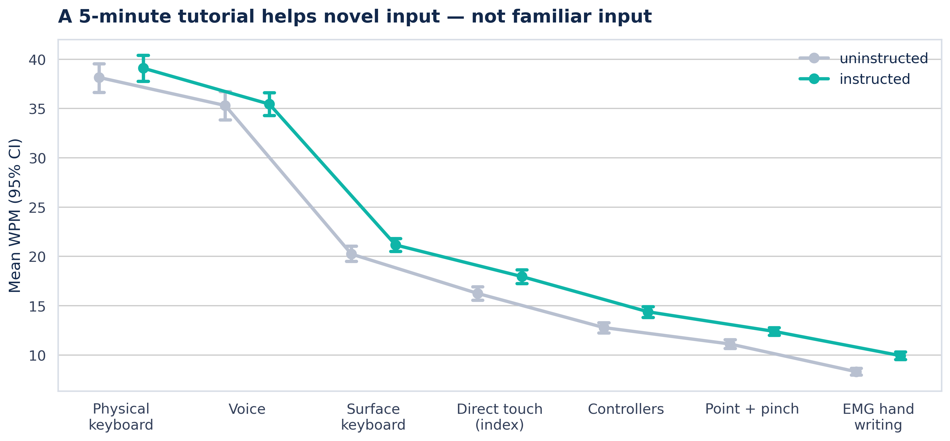
APPENDIX A · INSTRUCTIONS
Appendix: instruction split with 95% CIs
So what?
Teal (instructed) sits above grey (uninstructed) for EMG, pinch, controllers and direct touch — and overlaps for voice and physical.
▸ Between-subjects, n=25 per group.
▸ Overlap of CIs is why voice is read as ‘no effect’.
▸ Effect sizes are in data/instruction_effects.csv.
AR/VR Text Entry • Synthetic portfolio study — no real participants • N=50 simulated • See README for methods & reproducibility

Slide 20
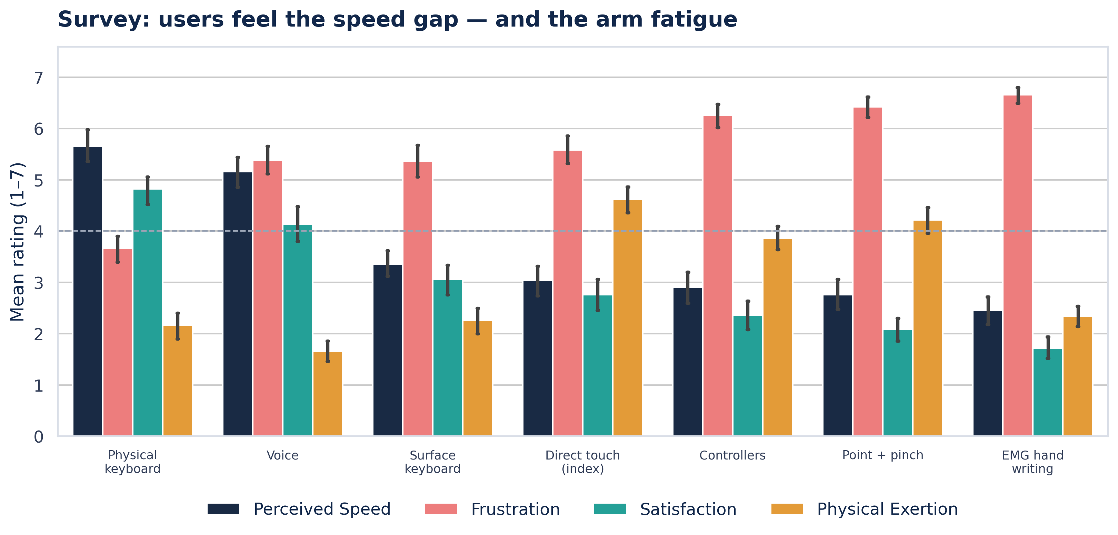
APPENDIX B · SURVEY DETAIL
Appendix: survey means with 95% CIs
So what?
The heatmap pattern holds with uncertainty shown: perceived speed separates cleanly, frustration stays high for every novel method.
▸ Dashed line = scale midpoint (4).
▸ 350 surveys, one per participant × method.
▸ Raw data: data/survey.csv.
AR/VR Text Entry • Synthetic portfolio study — no real participants • N=50 simulated • See README for methods & reproducibility

